Slide 1

Graphics: Rendering Basics
COMP4451 Game Programming

Slide 2
Reminders
Proposal due Friday, FEB27 at 11:59PM
Details on proposal doc in web page
Proposal presentation on Tuesday, MAR03 class
5-minute length
Bring PowerPoint slides and/or proposal PDF on USB (avoid downloading/copying)
Order will be randomly drawn

Slide 3
Rendering pipeline outline
Underlying concepts and algorithm
(This set of slides)
WebGL basics and detailed implementation
(Next set of slides)

Slide 4
GPU processing at a glance
Application
Vertex Processor
Rasterizer
Pixel Processor
Memory
Display

Slide 5
Programmability (later)
Application
Vertex Processor
Programmable
SIMD on GPU
“Shaders”
Rasterizer
Pixel Processor
Memory
Display

Slide 6
Processing geometry
Application
Vertex Processor
Rasterizer
Pixel Processor
Memory
Display

Slide 7
Geometry transformation
From object coordinates to screen coordinates

Slide 8
Geometry
Composed of two parts
Vertex data in a vertex array/buffer
Primitives in an index/element array/buffer
Vertices must include a position
Color, texture coordinates,… optional
Primitives reference one or more vertices
Triangles, lines, points
Geometry transformations act on vertices
And as a consequence change primitives too

Slide 9
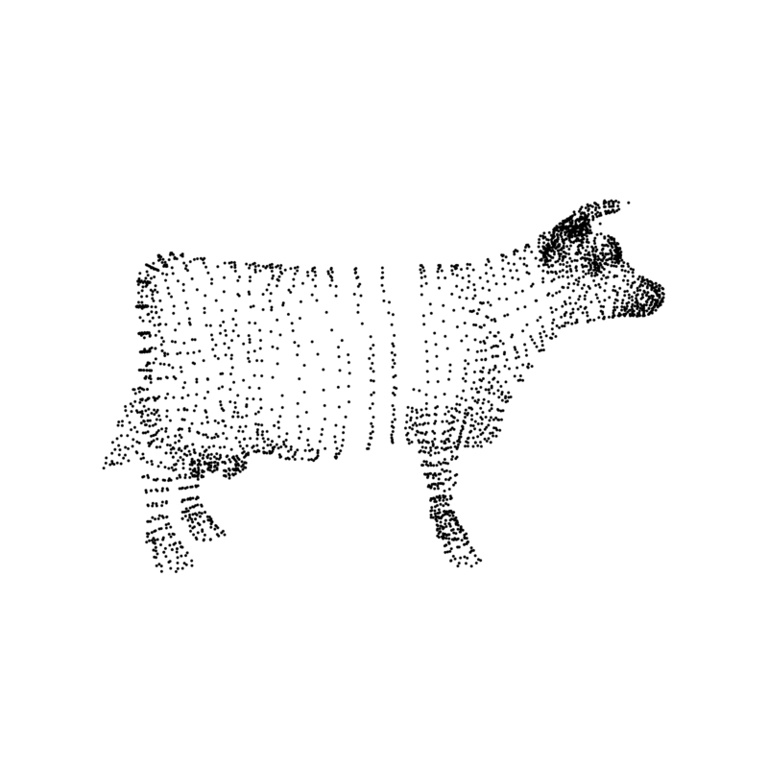

Slide 10
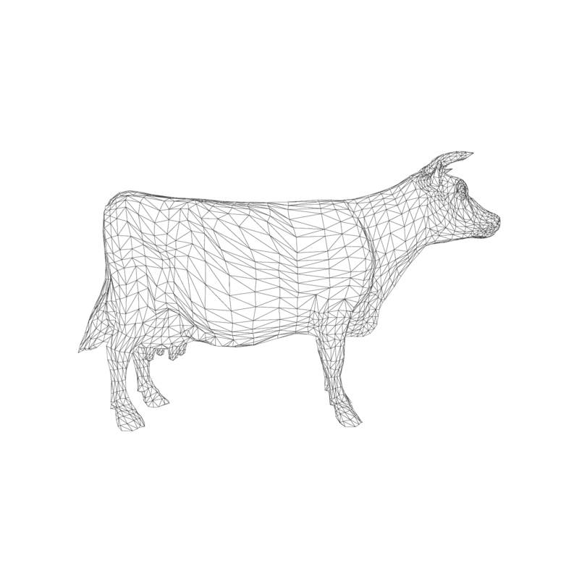

Slide 11
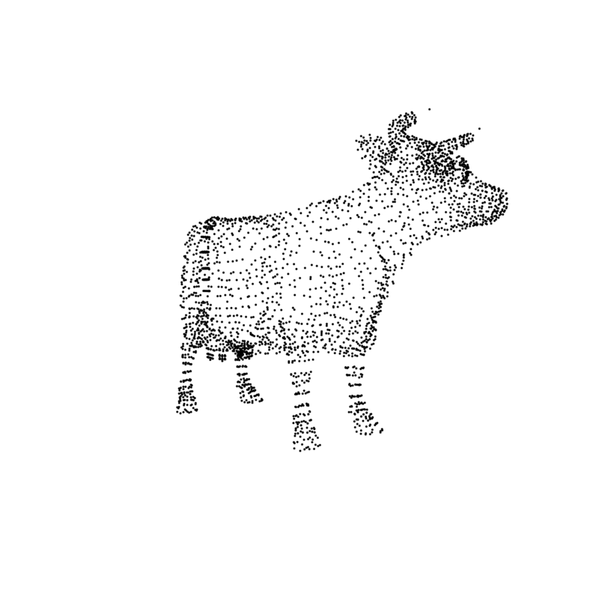

Slide 12
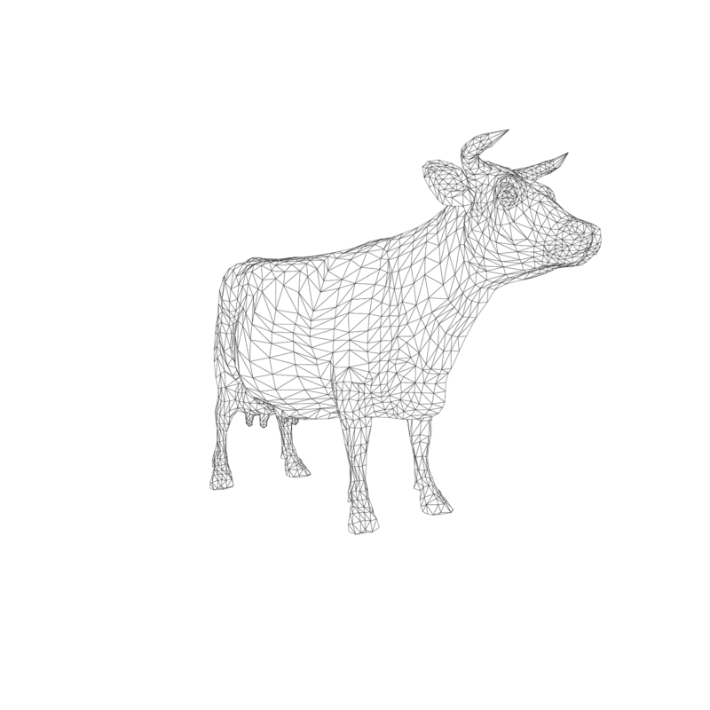

Slide 13

Vertex transformation
Object or Model Coordinates
World Coordinates
Eye or Camera Coordinates
Device Coordinates
Window or Screen Coordinates
Clip Space
Modeling
transformation
Viewing
transformation
Projection
transformation
Perspective
division
Viewport
transformation

Slide 14
Points, P (x, y, z)
Gives us a position in relation to the origin of our coordinate system

Slide 15
Vectors, V (x, y, z)
Is a direction in 3D space
Points != Vectors
Point – Point = Vector
Vector+Vector = Vector
Point + Vector = Point

Slide 16

Vectors V
Length (modulus) of a vector V (x, y, z)
|V| =
A unit vector: $\frac{V}{|V|}$

Slide 17
Dot (scalar) product
b
θ
a
a · b = |a| |b| cosθ
a · b = x_{a} · x_{b} + y_{a} · y_{b} + z_{a} · z_{b}

Slide 18
Projections (of b on a)
b
θ
a
a · b = |a| |b| cosθ
Assume |a|=|b|=1, then just cosine of angle
What if it is <0? ==0? >0?

Slide 19
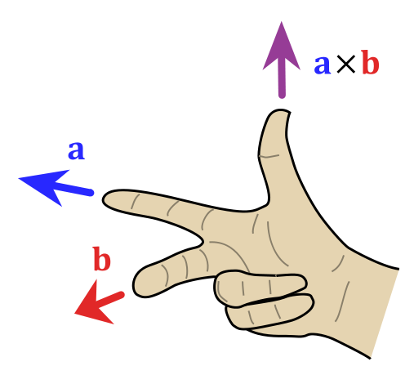
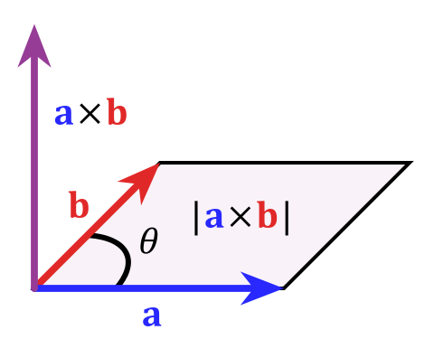
Cross (vector) product
Cross product orthogonal to two initial vectors
Direction determined by right-hand rule
Useful in constructing coordinate systems (later)

Slide 20
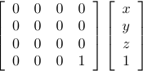
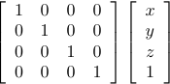
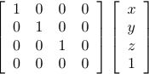
Positions in homogeneous coordinates
Borrowed from projective geometry
To each point (x,y,z) in R³, associate a line (x,y,z,w) in R⁴
The line goes through the origin and (x,y,z,1)
To go from R⁴ to R³, divide by w: (x/w, y/w, z/w)
Linear transformations in this space are more powerful

Slide 21
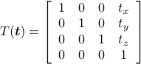
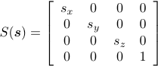
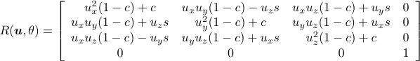
Modeling transformations
Object coordinates to World coordinates
Position, scale and orient objects in the world
Translation
Scaling
Rotation

Slide 22
Vertex transformation
Object or Model Coordinates
World Coordinates
Eye or Camera Coordinates
Device Coordinates
Window or Screen Coordinates
Clip Space
Modeling
transformation
Viewing
transformation
Projection
transformation
Perspective
division
Viewport
transformation

Slide 23

Viewing transformation
World coordinates to Eye/Camera coordinates
Combination of Translation and Rotation
Typically specified with: Eye, center, up

Slide 24
Vertex transformation
Object or Model Coordinates
World Coordinates
Eye or Camera Coordinates
Device Coordinates
Window or Screen Coordinates
Clip Space
Modeling
transformation
Viewing
transformation
Projection
transformation
Perspective
division
Viewport
transformation

Slide 25
Orthographic projection

Slide 26
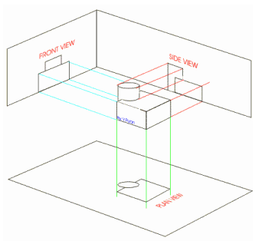
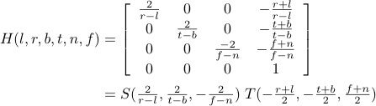
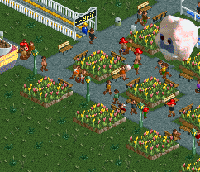
Orthographic projection

Slide 27
Perspective projection

Slide 28
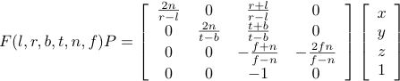
Perspective projection

Slide 29
Vertex transformation
Object or Model Coordinates
World Coordinates
Eye or Camera Coordinates
Device Coordinates
Window or Screen Coordinates
Clip Space
Modeling
transformation
Viewing
transformation
Projection
transformation
Perspective
division
Viewport
transformation

Slide 30

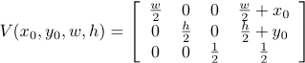
Viewport transformation

Slide 31
Rasterizing
Application
Vertex Processor
Rasterizer
Pixel Processor
Memory
Display

Slide 32
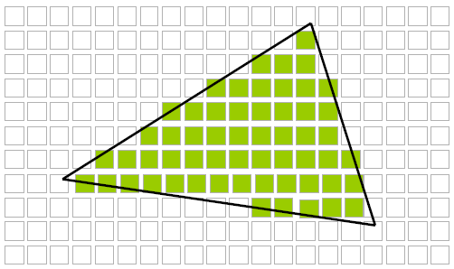
Rasterization
From vertices and primitives to pixels

Slide 33
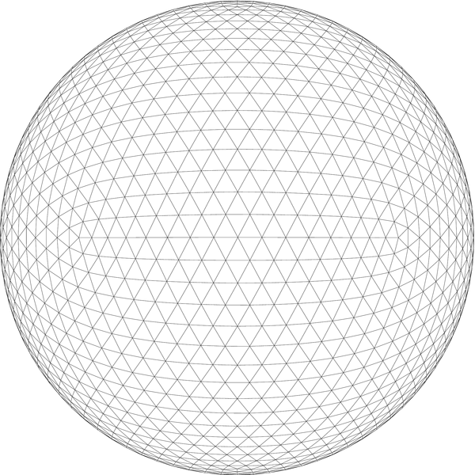
Before we start

Slide 34
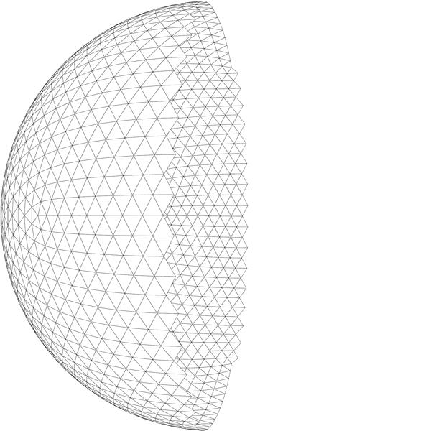
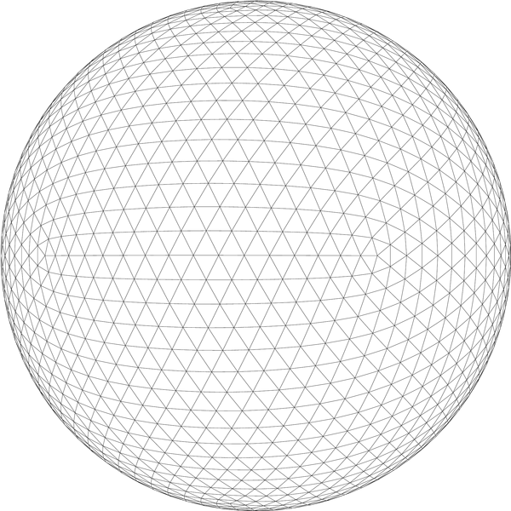
Front-faces

Slide 35
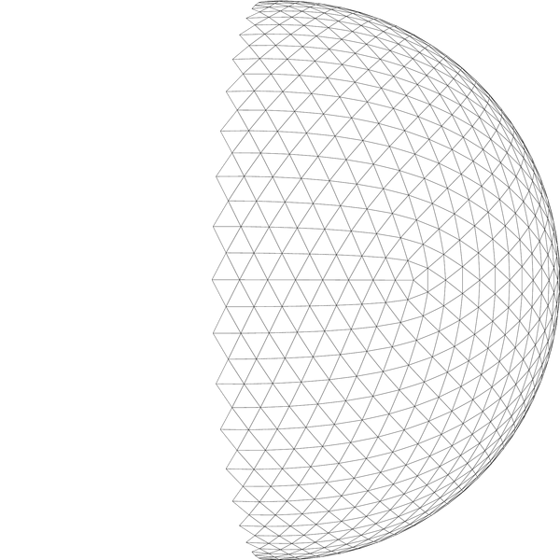
Back-faces

Slide 36
Backface culling
Don’t rasterize back-facing triangles
Or front-facing, you decide
Points and lines are always rasterized
One possible implementation
Look at 2D screen coordinates
Cross product Two possible orientations: A = (v2-v1)x(v3-v1).z
2
2
3
3
1
1

Slide 37
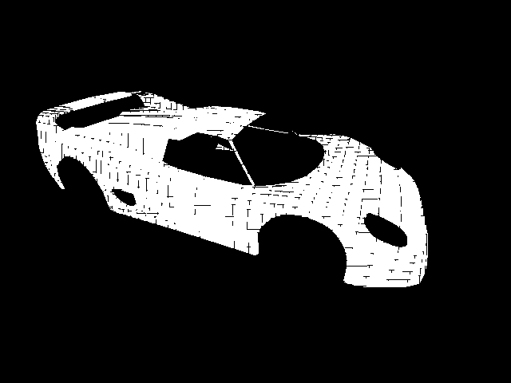
What if triangles share an edge?
Missing or repeated fragments
Neither triangle emits, both of them emit
Cracks or overdraw (when blending)
Image from “Advanced Rasterization”, Nicolas Capens, 2004

Slide 38
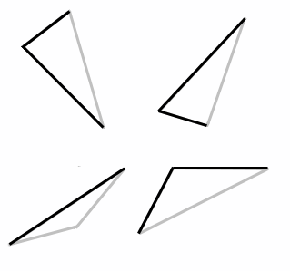
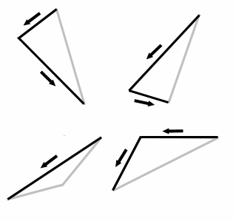
The top-left rule
Pixel center inside: emit fragment
Center on edge: emit if top edge or left edge
Top edges are horizontal and above all others
Left edges are not horizontal and are to the left
Triangles can have one or two left edges
Image from “Advanced Rasterization”, Nicolas Capens, 2004
Notes:
Looking at the counter clockwise vertex order, left edges are aways going down.
The top edge is horizontal, and the x goes left.

Slide 39
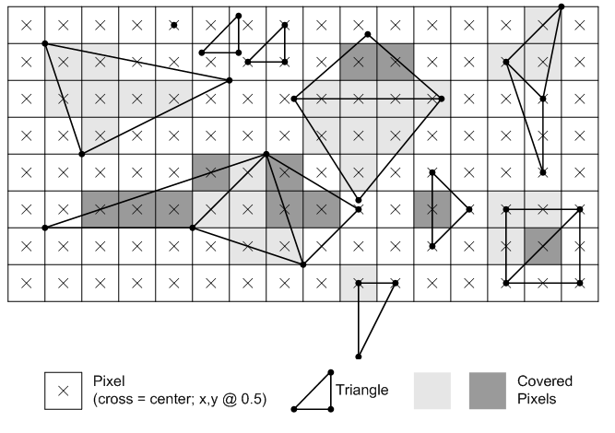
Top-rule examples
Image from “Microsoft’s Direct3D 10 Rasterization Rules”, 2010

Slide 40
Processing pixels
Application
Vertex Processor
Rasterizer
Pixel Processor
Memory
Display

Slide 41
Lighting and shading
So far, we’ve concentrated on geometry rendering
What is the shape of an object?
How do I place it in a virtual 3D space?
How do I view it through my virtual camera?
How do I know which pixels it covers?
Once we’ve answered all those, we have to ask one more important question:
What value do I set each pixel to?

Slide 42
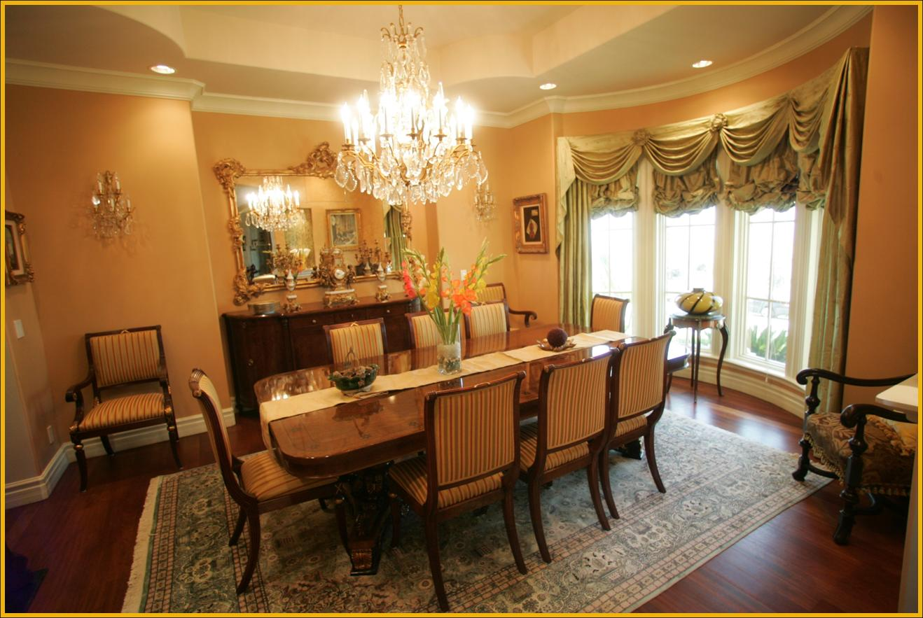
Difficult task
Look around the room!

Slide 43
Difficult task
Properly determining the right color is really hard.
There are trillions of photons, which can
interact with the atmosphere
strike a surface and
be absorbed
be reflected
cause fluorescence or phosphorescence
Of course, none of the surfaces here are perfectly flat. At some microscopic level (very important for photons) they’re all really bumpy.

Slide 44
Light Source
What is a light source?
Any object that emits radiant energy
Types of light source:
Directional
Point
Spot light
Advanced: extended and environment

Slide 45
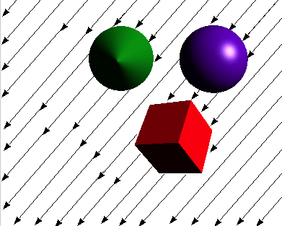
Directional Light Source
The light source is at infinity
Incoming light rays are parallel and of same intensity
Easy to compute because the incoming light direction is the same for all surface points

Slide 46
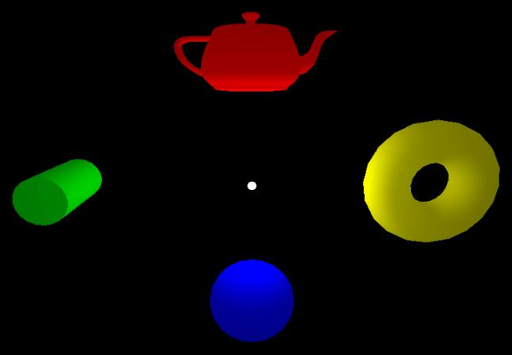
Point Light Source
A zero-volume light source located at a finite distance from the surface
Light rays goes out from the source in all directions
Harder to compute with because incoming light direction varies at each surface point
Distance attenuation: Can specify how the light goes dimmer with distance

Slide 47
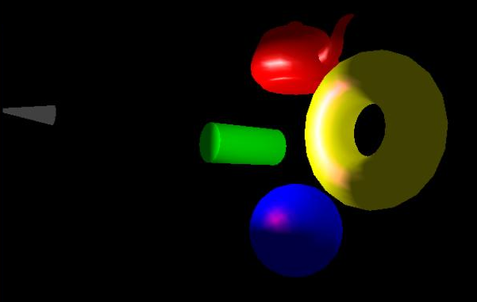
Spot Light Source
γ
Special Point Light pointing at particular direction (inherits all properties of point light source)
A cutoff angle restricts the shape of light emitted from source
In addition to distance attenuation, we may attenuate the intensity of light by measuring its deviation from the spotlight pointing direction

Slide 48

Extended Light Source
Extended Light Source, e.g. Line or Area (fluorescent lamp)
Every point along the line or within the area is a point light source
More Realistic, but computation is often very expensive
Produces soft shadows: umbra and penumbra
No direct support in OGL/DX.
We will discuss approximations later in the course.

Slide 49
Phong illumination model
We’re going to build up to an approximation of reality using the Phong illumination model, which describes the interaction between light and surface
It has the following characteristics:
Not physically based
Approximation to physical light reflection
Very fast
Widely used
Supported in graphics hardware

Slide 50
Iteration Zero
Given:
a point P on a surface
visible through pixel p
Assign each polygon a single color:
I = k_{e}
where
I is the resulting intensity (to be written to the frame buffer)
k_{e} is the intrinsic shade associated with the object (self emission)

Slide 51
Iteration One
Let’s make the color at least dependent on the overall quantity of light available in the scene:
I = k_{a} I_{a}
k_{a} is the ambient reflection coefficient of the object.
really the reflectance of ambient light
“ambient” light is assumed to be equal in all directions,
I_{a} is the ambient intensity of the light.
Physically, what is “ambient” light?

Slide 52
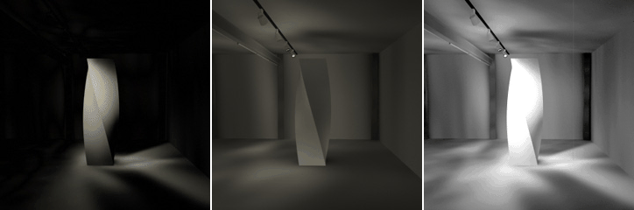
Indirect Illumination
Some surfaces are illuminated even if in shadow. Why?
Indirect lighting reflected from other surfaces
Each surface illuminated becomes itself a source of light for illumination on other surfaces of the scene.
Direct
Indirect
Direct + Indirect

Slide 53
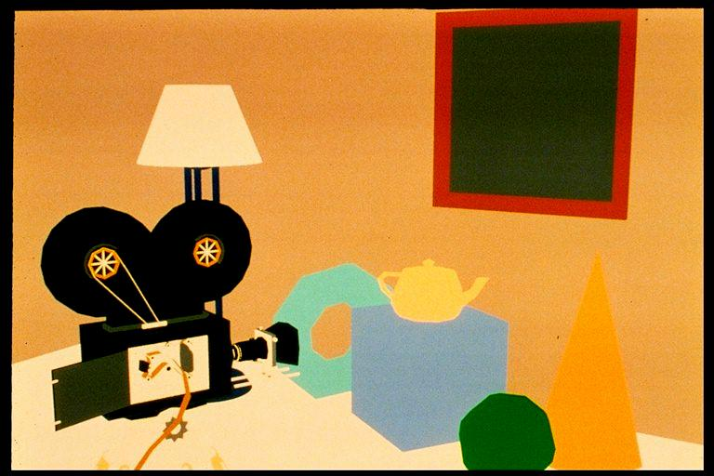
Ambient lighting
Very crude approximation of indirect ilumination: Simply assume the indirect lighting is constant (same at all surface points)

Slide 54
Diffuse Reflection
Let’s examine the ambient shading model:
objects have different colors
we can control the overall light intensity
what happens when we turn off the lights?
what happens as the light intensity increases?
what happens if we change the color of the lights?
So far, objects are uniformly lit.
not the way things really appear
in reality, light source contributions are directional
Diffuse, or Lambertian reflection will allow reflected intensity to vary with the direction of the light.

Slide 55
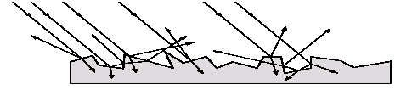
Diffuse Reflector
Diffuse reflection occurs from dull, matte surfaces, like latex paint, or chalk.
These diffuse or Lambertian reflectors reradiate light equally in all directions.
Picture a rough surface with lots of tiny microfacets.
Note:
Light may actually penetrate the surface, bounce around, and then reflect back out.
Accounts for colorization of diffusely reflected light by plastics.

Slide 56
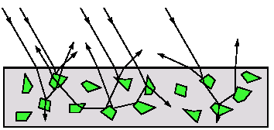
Diffuse Reflector
The reflected intensity from a diffuse surface does not depend on the direction of the viewer.
The incoming light, though, does depend on the direction of the light source.

Slide 57
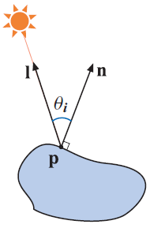
Lambert’s cosine Law
A diffuse surface is one which reflects light equally in all directions and obeys Lambert’s cosine law
I₀ is the incoming light intensity I is the reflected light intensity

Slide 58
Iteration Two
Based on Lambert’s cosine law, the diffuse reflection equations are:
I = k_{e} + k_{a} I_{a} + k_{d} I_{l} cos θ
= k_{e} + k_{a} I_{a} + k_{d} I_{l} ( N · L )+
where
k_{d} is the diffuse reflection coefficient.
I_{l} is the intensity of the light source
N is the normal at the surface point (unit vector)
L is the direction to the light source (unit vector)
Note that it is constant for a directional light source
(x)+ means max(0, x) (This is important!)

Slide 59
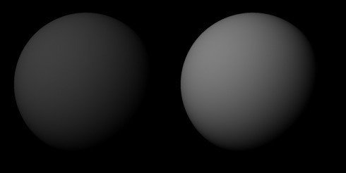
Diffuse Coefficient
Increasing the diffuse coefficient:

Slide 60
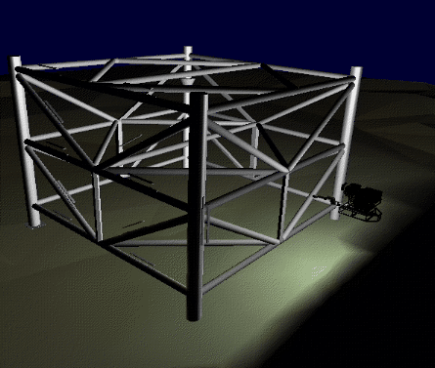
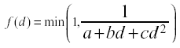
Light attenuation with distance
The laws of physics state that the intensity of a point light source must drop off with its distance squared.
We can incorporate this effect by multiplying by 1/d².
Sometimes, this distance-squared drop off is considered too “harsh.”
It is common to use user-supplied constants for a, b, c:

Slide 61
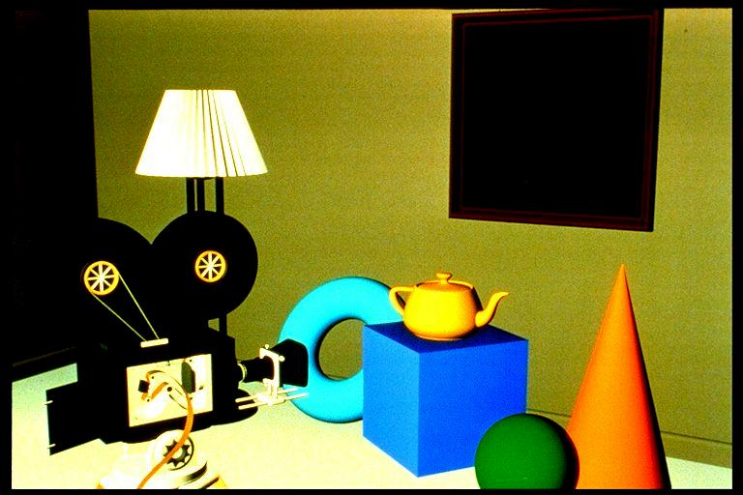
Diffuse lighting

Slide 62
Specular Reflection
Specular reflection accounts for the highlight that you see on some objects.
It is particularly important for smooth, shiny surfaces, such as:
metal
polished stone
plastics
Apples
Specular reflection also depends on the viewing direction V. The color is often determined solely by the color of the light.

Slide 63
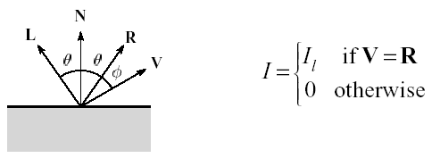
Specular Reflection
For a perfect mirror reflector, light is reflected about N, so
For a near-perfect reflector, you might expect the highlight to fall off quickly with increasing angle φ.
Also known as:
“rough specular” reflection
“directional diffuse” reflection
“glossy” reflection

Slide 64
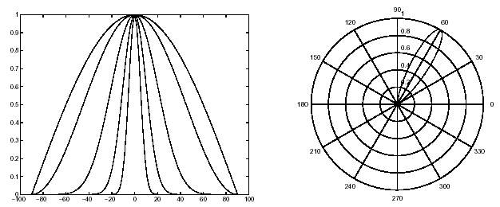
Specular Reflection
One way to get this effect is to take (R · V ), raised to a power n_{s} .
As ns gets larger,
the dropoff becomes more abrupt
gives a smaller highlight

Slide 65
Specular Reflection
Note: Changing the light direction

Slide 66
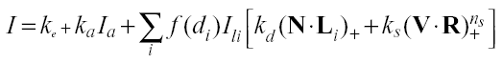
Iteration Three
Since light is additive, we can handle multiple lights by taking the sum over every light.
Our equation is now:
This is the Phong illumination model.
Beware of the max. operator ()+ in the above equation
Which quantities are spatial vectors?
Which are RGB triples?
Which are scalars?

Slide 67
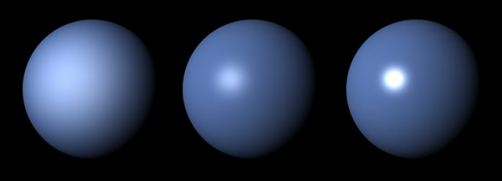
Specular Examples
Effect on varying n_{s}:
Increasing n_{s}

Slide 68
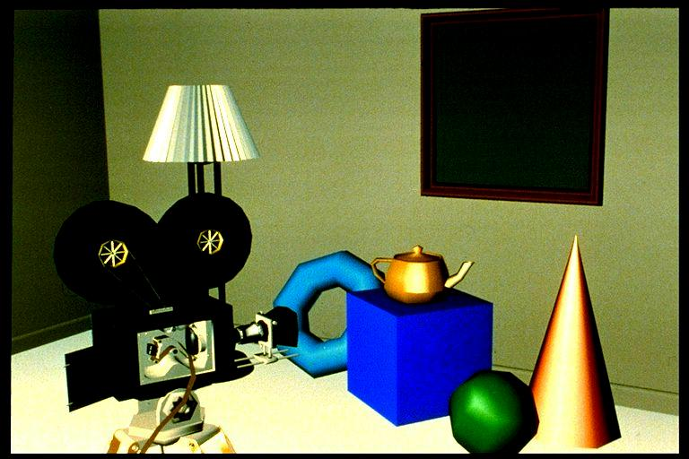
Diffuse + specular

Slide 69
Choosing the Parameters?
How would I model…
polished copper?
blue plastic?
lunar dust?

Slide 70
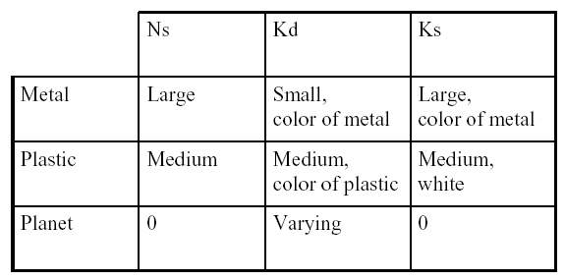
Choosing the Parameters
Ns in the range [0,100]
Try K_{a} +K_{d} + K_{s} <= 1
Use a small K_{a} (~0.1)

Slide 71
Appearance of a
diffuse (dull) sphere
3D plot of reflected intensity

Slide 72
Appearance of a
specular sphere
3D plot of reflected intensity
n = 15

Slide 73
k_{d} = 0.7
k_{s} = 0.4
n = 15

Slide 74
k_{d} = 0.85
k_{s} = 0.25
n = 15

Slide 75
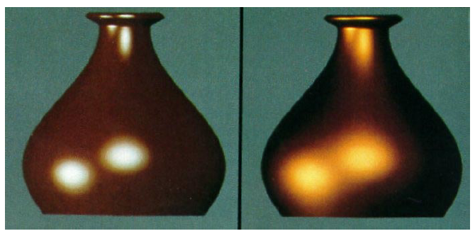
Choosing the Parameters
More specular
More diffuse

Slide 76
Summary for the four components
in the Phong Illumination model
 | Emission (0th iteration) | Ambient (1st iteration) | Diffuse (2nd iteration) | Specular (3rd iteration)
Depends on surface property | Y | Y | Y | Y
Depends on light intensity | N | Y | Y | Y
Depends on light direction | N | N | Y | Y
Depends on viewing direction | N | N | N | Y

Slide 77
Summary for Phong Model
The most important thing to take away from this section is the final equation for the Phong model.
What is the physical meaning of each variable?
How are the terms computed?
What effect does each term contribute to the image?
What does varying the parameters do?
Note:
It allows us to compute the color emitted along a given viewing direction from a given surface point
This is still an approximation for light-surface interaction; this is still an active research area: there exist a number of more complicated models.

Slide 78
Interpolative Shading

Slide 79
Interpolative Shading
Remember that most graphics hardware can only draw polygons.
Smooth curved surfaces have to be polygonized in order to be displayed.
If you shade each surface honestly using the Phong illumination model, you will see ….
The surface is not smooth when display.

Slide 80
Interpolative Shading
Smooth surfaces are often approximated by polygonal facets because:
Graphics hardware generally wants polygons
We know how to intersect rays with polygons
How do we compute the shading for such a surface?
Interpolative shading

Slide 81
Interpolative Shading
To recover (approximately) the visual appearance of curved surface.
Assumptions
1) An approximate normal (vertex normal) at each vertex can be computed by averaging the normals of the polygons sharing that vertex.
2) The shading of a particular pixel can be obtained by a bilinear interpolation of the appropriate quantities from adjacent vertices.
N_{p}=(N₁+N₂+N₃+N₄) / 4

Slide 82
1. Gouraud Shading
Calculate the intensity at each vertex using the local reflection model
Intensities of interior pixels are determined by bilinearly interpolating the vertices’ intensities (remember the rasterization section)
Interpolation equations are: Ia = [ I1 ( ys- y2 ) + I2 ( y1 – ys ) ] / ( y1 - y2 ) Ib = [ I1 ( ys- y3 ) + I3 ( y1 – ys ) ] / ( y1 - y3 ) Is = [ Ia ( xb- xs ) + Ib ( xs – xa ) ] / ( xb – xa )

Slide 83
1. Gouraud Shading

Slide 84
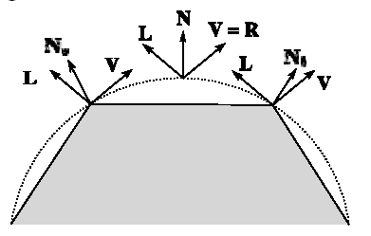
1. Gouraud Shading
Flaws of Gouraud Shading:
1) Highlight anomalies
If the highlight appears in the interior of the polygon, Gouraud shading may fail to shade this highlight because no highlighted intensities are recorded/calculated at the vertices.
Simple solution: smaller polygons

Slide 85
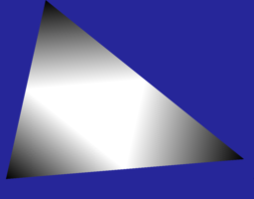
1. Gouraud Shading
Flaws of Gouraud Shading:
2) Banding
Human visual system emphasizes intensity changes occurring at a
boundary, which creates a banding effect. The bands can be obvious
if insufficient polygons are used to model area of high curvature.
Again, simple solution: smaller polygons

Slide 86
2. Phong Shading
Instead of interpolating the vertex intensities, Phong interpolates vertex normal vector.
More accurate and solves the interior highlight problem:
Interpolation equations are: N_{a} = [ N₁ (y_{s}- y₂) + N₂ (y₁-y_{s}) ] / (y₁ - y₂) N_{b} = [ N₁ (y_{s}- y₃) + N₃ (y₁-y_{s}) ] / (y₁ - y₃) N_{s} = [ N_{a} (x_{b}- x_{s}) + N_{b} (x_{s}-x_{a}) ] / (x_{b} - x_{a})

Slide 87
2. Phong Shading
Notes:
Since illumination calculation has to be invoked at each interior surface point, Phong shading is more expensive than Gouraud shading.
Do not mix up Phong shading and Phong model (Phong Illumination model). They are different things!

Slide 88
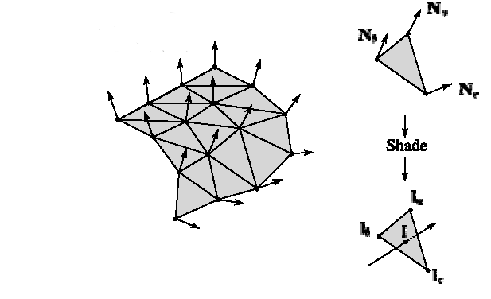
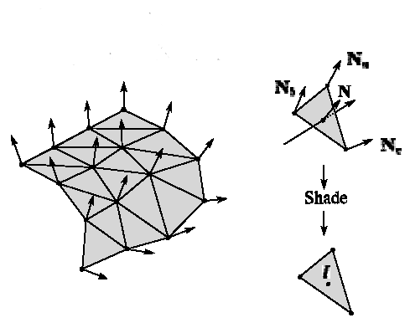
Gouraud vs Phong Shading
Gouraud Shading
Compute vertex normals
Shade only vertices (using Phong equation)
Interpolate the resulting vertex colors
Phong Shading
Compute vertex normals
Interpolate normals and normalize
Shade each pixel using the interpolated normals (using Phong equation)
Gouraud interpolation
Phong interpolation

Slide 89
Gouraud shading (diffuse+specular)

Slide 90

Phong shading (diffuse+specular)

Slide 91
Summary for Interpolative Shading
Here’s what you should take home from this section:
Gouraud shading
Phong shading
Their comparative advantages and disadvantages
Anomalies in interpolative shading
http://www.youtube.com/watch?v=PMgjVJogIbc

Slide 92

Lighting in OpenGL: Nate Robin’s lightmaterial.exe

Slide 93
Texturing

Slide 94

Texturing
Modify surface appearance at each point using an image, function, procedure, etc
Image from “ATI Toyshop demo”

Slide 95

Projector function
Maps 3D positions to parameter space
Spherical
Cylindrical
Planar

Slide 96

uv-projection
Unwrapping: It’s really the artist’s problem

Slide 97

Corresponder function
Maps parameter space to texture coordinates
Range in [0,1)
Typically wrap, mirror, clamp, border

Slide 98

Texture and image coordinates
Uses the dual grid
First pixel center not at u = 0
Can replace image resolution without changing texture parameters
Simplifies mipmapping
In a minute

Slide 99

Texture lookup
Filtering strategy depends on sampling
i.e., on mapping between screen and textures
Depends on geometry & projection too!
Screen space
Texture space

Slide 100
Magnification & minification
Check screen pixel “size” in texture coordinates
or
Magnification
Minification

Slide 101



Computing the partial derivatives
How does the hardware compute the derivatives?
Do fragments talk to each other?
Fragments are processed in 2x2 “quads”
Use one-sided discrete derivative approximation
Execution is in lock-step, so this is trivial

Slide 102
Some issues with derivative computation
Border overhead
Too many boundaries, a lot of overhead
Precision issue
It is just a first order approximation
May create artifacts if your function’s second derivative is crazy

Slide 103
Magnification
Hardware supports nearest and linear filtering
Linear filtering is free
It is also not particularly good
Nearest
Linear

Slide 104




Nearest magnification

Slide 105




Linear magnification

Slide 106




Interpolating cubic B-spline magnification
(not supported natively in hardware)

Slide 107








Even better magnification
Possible with vector graphics
Resolution independent information

Slide 108

Minification
Harder than magnification
Many alternatives
Hardware supported:
Mipmapping
Anisotropic filtering
Can we take all pixels into consideration in real-time?
How?

Slide 109

Mipmapping
Precomputed levels of detail in a pyramid

Slide 110
Hardware support for mipmapping
Use local derivative to compute level of detail
Nearest
Select nearest pyramid level
Sample from it
Nearest or linear
Linear
Find neighboring pyramid levels
Sample both
Nearest or linear
Blend results linearly
Sometimes called trilinear filtering

Slide 111

Mipmapping memory requirements
Not even twice the number of bytes!
Only ~33% more

Slide 112

Anisotropic filtering
What if Jacobian is not squarish?
Take more than 1 sample
More samples in longer direction (done by GPU)
Just MIPmapping
Anisotropic filtering

